Slide 1
Welcome to
A Leader Builds Partnerships
February 2024
Presenter Team:
Anita McDonald, IPDG D5500
Ricardo “Taco” Loretta, PDG D5330
Sandy Matsui, PDG D5000
Kathleen Terry, D5280
Notes:
Welcome and Congratulations Presidents Elect on being selected to lead your club. I’m Anita McDonald You may have already been told that being President is the best job in Rotary.
Presenter:Take a moment to positively speak about your personal experience as club President.
Presenter to attendees: What came to your mind when you saw the title “Leaders Build Partnerships” with the operative word being “partnerships?” . Seek 2 or three responses.
Raise your hand if you have a partnership with an organization such as a Lions or Kiwanis club, school/school district, a local business-large or small, a nonprofit, a gov’t agency or another Rotary club?
How many have none?
How many don’t know?
INSERT SLIDE W/RI PARTNER LOGOS & OTHERS
Presenter: Speak to the partnerships that RI has fostered and the impact of these partnerships. Examples: the success of the Polio Eradication (WHO, UN, Gates Fdn, etc.). More recent with ShelterBox, Toastmasters, Habitat for Humanity and…???………)

Slide 2
Sessions Goals:
Why Partnerships –
The Benefit/Impact of Good Partnerships
Components to Consider when Developing Partnerships
Notes:
Our session will focus on the Why we as leaders should consider Partnerships and what are their Benefits; And the important components of developing a partnership or assessing and nurturing current partnerships.
The components we will keep in mind are. ---- click to next slide

Slide 3
FOUR PRIORITIES
Increase
our impact
Expand
our reach
Together, we see a world where people unite and take action
to create lasting change —
across the globe, in our communities, and in ourselves.
Enhance
participant
engagement
Increase
our ability to adapt

Slide 4
Potential Benefits of a Partnership
Build Rotary’s BRAND – Increase awareness and knowledge about Rotary
Increase Number of Volunteers
Potential New Members
Increase overall IMPACT and VISIBILITY of Project
Enhance or enable partner to achieve their goal
Smaller Rotary clubs can work on bigger initiatives
Maximize use of available resources
Minimize duplication of efforts
Notes:
Given the numerous benefits of partnering, let’s look at the important components in creating a win-win partnership OR maintaining or enhancing a current partnership.
Presenter: Click to next slide
The first is knowing your club. What’s the primary focus area of your club. What are you known for in the community? Do you have a vision or Planning Document? If so does your focus area support your mission and does it support Rotary’s Seven areas of Focus.
Take 3 minutes and write down your focus area. If you don’t have one, write down one you’d select if you were Queen or King for a day.

Slide 5
Components
Knowing the Club Service Focus
Having a Strong Value Proposition
Defining a Potential Project/Activity
Identifying Potential Partners
Setting Project S.M.A.R.T. Goals
Approaching Like Minded Potential Partners
Notes:
Presenter:
Prior to presenting the next slide engage in discussion with PEs about different types of partnerships based upon their examples and those of the presenters and the WHY of the partnering and the BENEFITS (Do those being served and all partners benefit?)
Presenter:
Based upon discussion, ask what are some of the benefits of partnering?
After PEs have responded, share the next slide – the Summary of Benefits
If there were some benefits shared that are not on the slide, they will be added before the presentation is sent to them.

Slide 6
Developing a Partnership
STEP 1: Identify Your Focus
Do you know who you are as a club?
Does your club have a signature activity?
Let’s Define Your Area of Focus
Notes:
The first is knowing your club. What’s the primary focus area of your club. What are you known for in the community? Do you have a vision or Planning Document? If so does your focus area support your mission and does it support Rotary’s Seven areas of Focus.
Take 3 minutes and write down your focus area. If you don’t have one, write down one you’d select if you were Queen or King for a day.
ASK ATTENDEES FOR A FEW EXAMPLES.
PRESENTER Comments:
A suggestion is to hold a discussion with your Board about the topic. Will they agree with you regarding the focus area?
If your club doesn’t have a specific/general focus area, how do they feel about having one?

Slide 7
The 7
Areas of Focus
PEACE BUILDING
& CONFLICT
PREVENTION
SUPPORT THE ENVIRONMENT
EDUCATION
& LITERACY
DISEASE PREVENTION & TREATMENT
MATERNAL & CHILD HEALTH
COMMUNITY ECONOMIC DEVELOPMENT
WATER,
SANITATION & HYGIENE

Slide 8
Developing a Partnership
Step 2: Develop A Strong Value Proposition
What makes your club unique and differentiates it from other non-profit organizations, especially for the potential partner?
Let’s build a VALUE PROPOSITION
Notes:
A clear Focus Area of service will help you to develop a strong Value Proposition. What is a Value Proposition?
What makes your club unique and differentiates it from other non-profits?
What are the things that your club/ or any club brings to the table?
Brief Discussion:
Presenter. - Ideas to share:
Commitment to serve/help others
A demonstrated track record of impactful service
Access to expertise (whether in the club the District, Zone or RI)
Ability to leverage funds
Committed volunteers
LET’S BUILD A VALUE PROPOSITION

Slide 9
Developing a Partnership
Building a Value Proposition
BRAND
The name of your Rotary Club
TARGET
Businesses you want to collaborate with
[BRAND] is the product of choice for [TARGET] that [POINT OF DIFFERENTIATION / VALUE] because [REASON TO BELIEVE]
POINT OF DIFFERENTIATION/VALUE
What makes your Rotary Club unique and valuable to your target businesses
REASON TO BELIEVE
Proof that supports your claim of being unique and valuable
Notes:
Building your Value Proposition: [On your hand out or in your packet] you will find the outline that appears on the left side of the screen. Before, you write your Value Proposition, let me share an example with you.
Example 1:
BRAND: The Catalina Rotary Club focuses on Children & Youth in Need and has a special interest in Empowering Girls to become confident, strong leaders that will become confident leaders as adults.
TARGET: organizations or businesses with a strong commitment to the leadership development of girls and women.
POINT OF DIFFERENTIATION/VALUE:
The Catalina Rotary Club has a community-wide network of Rotary members and community members committed to this goal. We have access to experts in thisfield throughout our community, our country and the World.
REASON TO BELIEVE: held a workshop offering information in the fields of education, leadership development, mental and physical wellness to those interested in providing these skill areas to girls in their community.
Value Proposition Statement:
The Catalina Rotary club partners with organizations and businesses that have a strong commitment to the leadership development of girls and women by offering special workshops, mentoring, and other opportunities, utilizing our local and global network of members who are experts in this field. Recently we held a workshop addressing the fields of education, leadership development, mental and physical wellness for 125 individuals interested in providing these skill areas to girls or women in the community and in their workplace.

Slide 10
Value Proposition Statement The Rotary Club of XXX partners with businesses and organizations that enable girls to become agents of positive change in their lives by providing resources through service projects, education, vocational mentoring, and leadership development utilizing global and local networks of experts. .
BRAND
The Rotary Club of
XXXXXXX
-------------------
focuses on Youth Services and has a special interest in Empowering Girls to become agents for positive change
in their own lives,
in their families, and in their community
TARGET
Organizations that engage with projects focusing on the needs of girls’
Health and wellness
Education
Safety and well-being
Economic development
POINT OF DIFFERENTIATION
VALUE
Provide meaningful opportunities to make a difference through service projects, education, vocational mentoring, and leadership development.
REASON TO BELIEVE
Unique ability to leverage global and local networks of Rotarians to form partnerships with experts in the field

Slide 11
Developing a Partnership
Step 3: Identify Potential Project/Activity
Once you have a focus and a well stated value proposition, it’s time to address the final three components.
First,what is it that you want to do that having a partner would be value added?
Identify a project or activity.

Slide 12
Developing a Partnership
Second: Identifying your Partner
This is an opportunity to generate club excitement and buy-in.
Let’s think about things to consider when trying to IDENTIFY YOUR PARTNER

Slide 13
Developing a Partnership
The Club’s Networks
Member Networks
When working to IDENTIFY YOUR PARTNER
consider all your options
Local Businesses
Guest
Speakers
Social
Media
Online Research
Rotary Partners
Other
Notes:
Presenter: Here are various ways that you can engage the entire club, to help with identifying potential partners.
In addition, the PEs will find some prompts on contacting potential partners via email, text or phone in their information packet.

Slide 14
ROTARY PARTNERS
ROTARY
PARTNERS
Notes:
Presenter: Here are various ways that you can engage the entire club, to help with identifying potential partners.
In addition, the PEs will find some prompts on contacting potential partners via email, text or phone in their information packet.

Slide 15
Developing a Partnership
Step 4: Building S.M.A.RT objectives for your project
How do you plan to measure your progress/success towards your goal?
Work together with your partner to create S.M.A.R.T. Goals and Objectives.

Slide 16
SMART Objectives Defined:
Notes:
Presenter:
Read through the SMART definitions for the attendees, adding any comments as appropriate.
Inform the PEs that the framework for writing SMART goals and objectives is in their packet if they need a little assistance.

Slide 17
Developing a Partnership
Step 6: Seek a LIKE-MINDED PARTNER
Finding the right partner does not happen overnight.
Take the time and steps needed to find the right match.

Slide 18
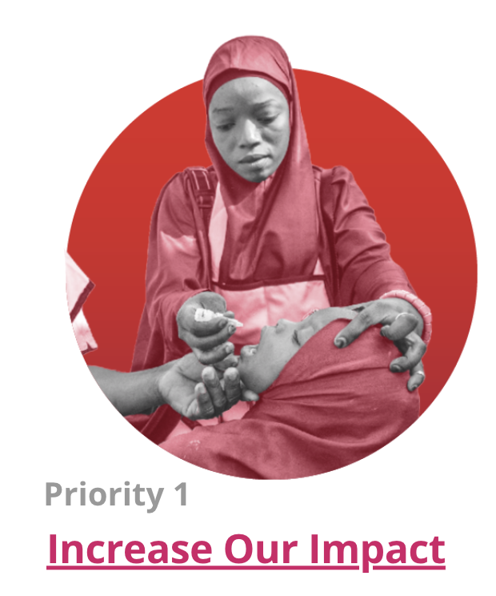
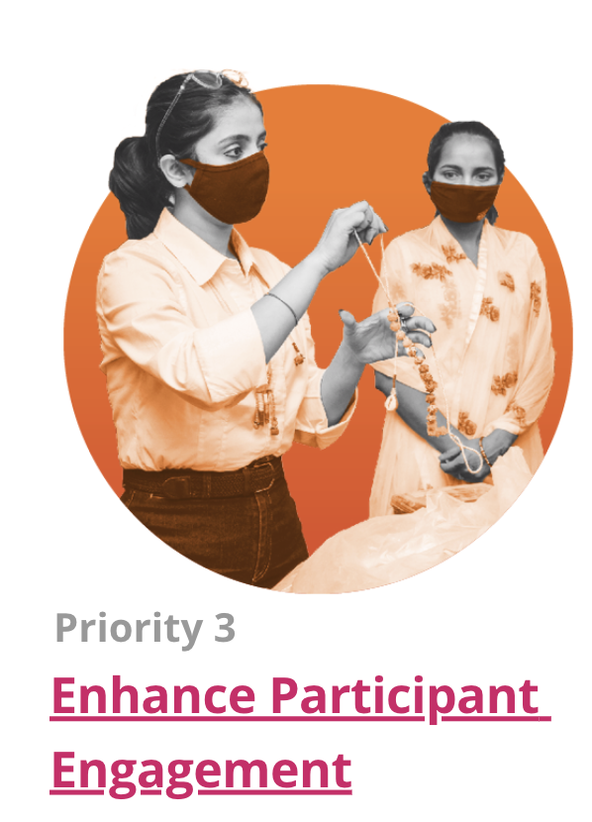
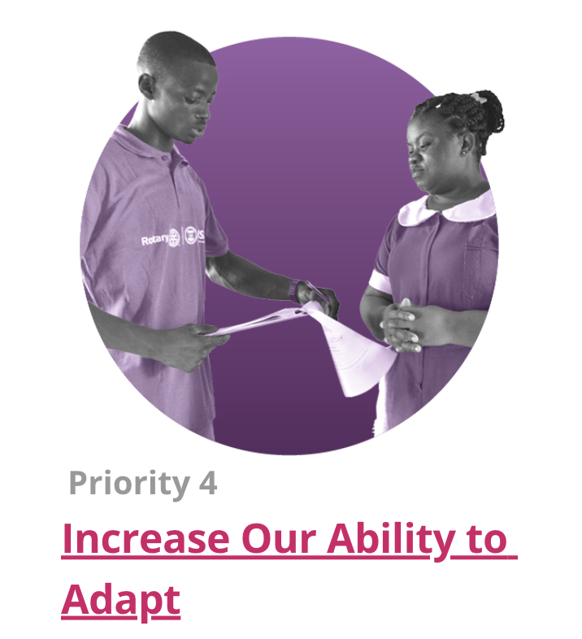
Together, we see a world where people unite and take action
to create lasting change —
across the globe, in our communities, and in ourselves.
REMEMBER THE WHY!
Visibility & Brand Awareness
with New Rotary Friends & Members

Slide 19
SUMMARY
Your Roadmap to Building Partnerships
Identify your Focus
Develop a Strong Value Proposition
Identify Project and set SMART Objectives
Identify Potential Partners
Pursue Like-minded Partners

Slide 20
Leaders Build Partnerships
Call to Action
Identify an action you are going to take as a Leader to
Build Partnerships
Notes:
Presenter: Here are various ways that you can engage the entire club, to help with identifying potential partners.
In addition, the PEs will find some prompts on contacting potential partners via email, text or phone in their information packet.

Slide 21
Thank you!!
Questions??

