Slide 1
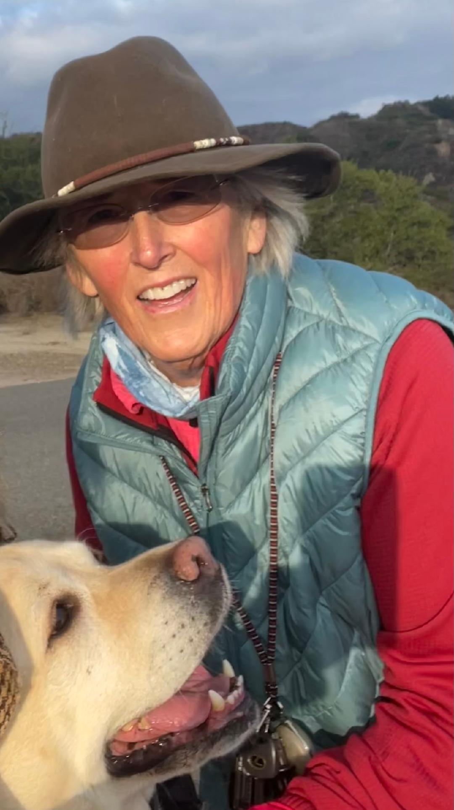
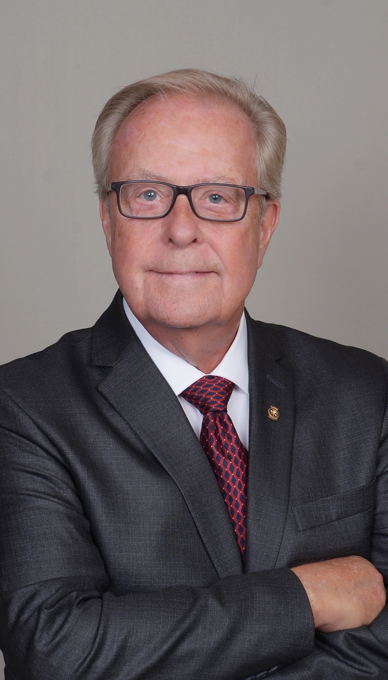
Welcome to THE ELECTIVE: “Diverse People of Action”
CISCA STELLHORN, PDG
D5320
Rotary Club of
Irvine
DG 2021-22
WILLIAM CHASE, PDG
D5330
Rotary Club of
Palm Springs
Sunup
DG 1989-90
D6400

Slide 2
Welcome to Diverse People of Action
Objective:
To stimulate your creativity toward membership, engagement and service
Briefly look at Rotary History
Look at who we are and why we stay
Explore where we can go from here

Slide 3
Rotary is an Eclectic group of individuals
Started for fellowship and networking then expanded to Service. It was a privilege to “belong”
You had to be asked and it was limited access.
We call it the “Family of Rotary”.
Today it is similar but very different. It is open to all – but is it really?
We now have women members. But who is missing?

Slide 4
How do we continue to thrive ?
Rotary, globally, gains about 150,000 people a year but loses 160,000 (Not much thru death). Rotary is growing in other parts of the world but stagnant in North America.
What can we do?
How many of you are worried about membership? About funding service projects?
Do you have a plan?
I have a thought.

Slide 5
Question?
Think for a moment about your club membership.
How are your members similar? How are they different?
Do they reflect the demographics of your local community?
Do they reflect the demographics of those you serve? i.e. service projects?
Who is not represented? Who is missing from the table?
What does your fellowship look like? Friendships?

Slide 6
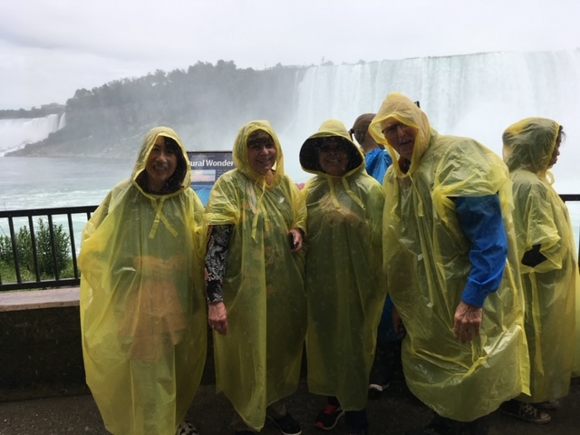

Slide 7
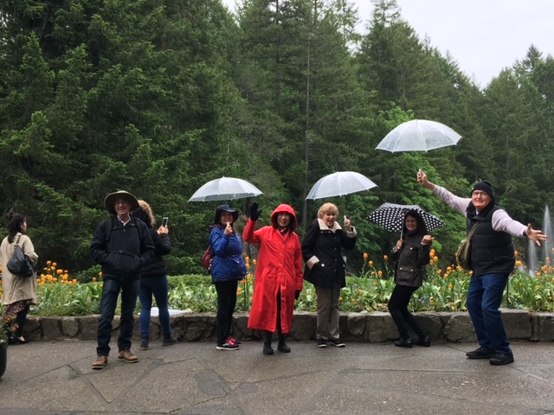

Slide 8
Belonging and community
Paul Chapel teaches us that ‘belonging’ is an essential human need. We need to belong to a community.
Rotarians foundationally create community-fellowship.
What does your club community look like?
Does it reflect your service community?
Has it changed over the years? Why?
Pics in time-

Slide 9
Vision brings members in- Failure of Leadership encourages them to leave
As Leaders do we make our members feel that they belong? Do we make potential members feel that they want to belong to our Rotary club?
If you continue to do what you are doing you will continue to get what you have. Any road will get you there if you do not know where you are going?
So where are you going?

Slide 10
Eclectic engagement-
Deriving ideas, style or taste from a broad and diverse range of sources
Diverse thinking.
Research shows that corporations with a diverse work force are 15% more profitable.
Why do you think that is?
How could more diversity impact your club membership?

Slide 11
First LET’S Consider YOUR LEVEL OF Emotional Intelligence
How do you recognize and incorporate a sense of belonging? Friendship?
How do you come across to others?
Are you inclusive?
Do you consider the feelings of others first?
How do you motivate yourself and others?
How do you manage relationships and achieve goals?

Slide 12
What about unconscious Bias and its impact on membership
Bias is not good nor bad.
It is a preference that impacts judgment.
We just need to learn to be aware of it.
Example-Judge

Slide 13
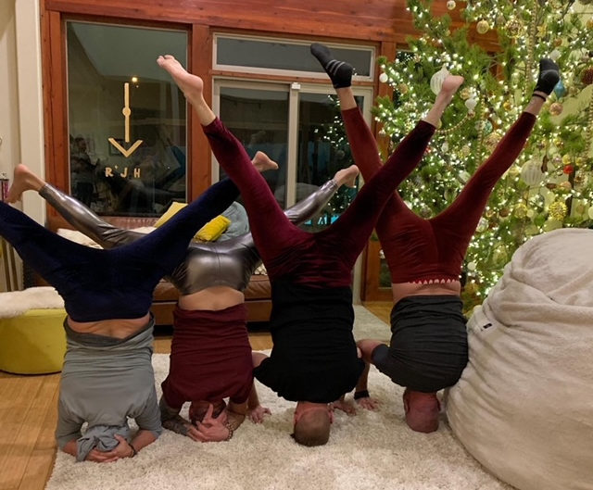

Slide 14
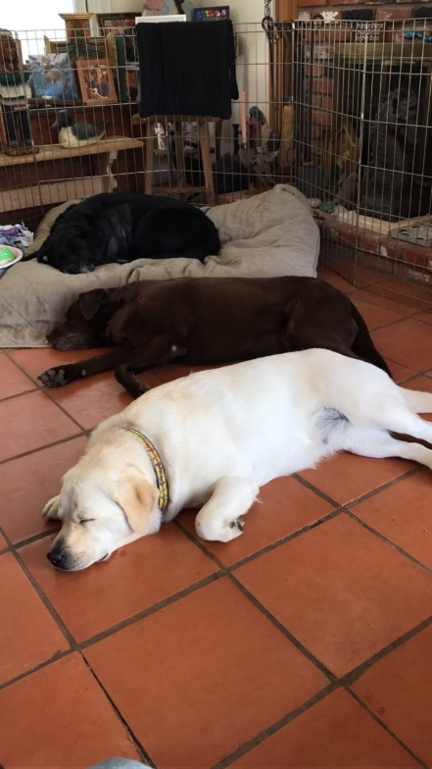
Can you tell?

Slide 15
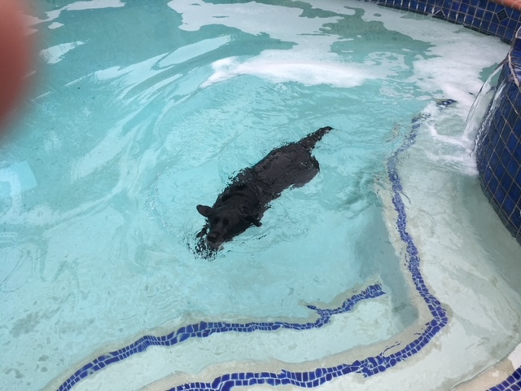
Would you want her on your swim team?

Slide 16
How about now?

Slide 17
Could unconscious bias be effecting membership?
How much time do you spend getting to know your members? Their families? Their skill or need set?
Do any of you use an exit survey? Poll your members on their satisfaction, or lack thereof, with the club?
Do you follow up with potential members to see why they have not joined?
Could that be valuable?
How?

Slide 18
Overcoming Unconscious Bias
Look at:
Was your first thought realistic?
Was it logical?
Can you ignore the thought and reconsider?
Is there common ground?
Can you pause and regroup?
What could be a result of overcoming bias?

Slide 19
Key points to creating a culture of belonging (the Family of Rotary)
1. Celebrate each persons contribution. Advance equity. Create an inclusive culture where everyone knows that they are valued.
2. Strive to increase awareness and understanding of the beneficial impacts of being diverse.
3. Ensure that everyone feels welcome, respected and valued.

Slide 20
Other things to do to create an eclectic inclusive culture
Create a committee-explore Demographics
Promote initiatives in your newsletter or on your website
Update your clubs policies and governing documents
Host a community form
Schedule speakers on the topic

Slide 21
We are unique by our values, Principles and approaches that include:
Rotary Code of Conduct
Four-Way Test
The Eight Pillars of Peace
The Object of Rotary

Slide 22
closure
What is important is that we look at what we are doing to engage. Explore why members are joining and leaving.
Who is missing from the table.
Who would be an asset to Rotary and how can we be an asset to them.
We are here to make the world a better place and we do that through the community of Rotary, the family of Rotary.

Slide 23
Elective SURVEY FOR PARTICIPANTS: 1. Did you learn anything? Yes___ NO___ 2. Did it stimulate your curiosity and motivate you WANT to learn more? YES___ NO___ 3. Overall Rating of this course: 1-10: ( 1 the lowest and 10 IS the highest)

