Slide 1
FUNDRAISING
PDG Taco Loretta
QUESTIONS
Why are we fundraising?
What we will do with funds we raise?
NOT talking about raising funds to pay
club dues to RI & District!

Slide 2
FUNDRAISING
PDG Taco Loretta
WHY Are We Fundraising?
Examples of what clubs do with funds they raise:
-Many clubs raise funds for RYLA or Scholarships
-Help members attend District events
-Palm Desert RC has a Food Insecurity focus

Slide 3
FUNDRAISING
PDG Taco Loretta
Other Questions?
Is this a “Large” Fundraise (>$5,000)?
How many Revenue streams?
If it includes raffle, need a permit (easy to get)

Slide 4
D5330 Gala Fundraiser Breakdown
(one of most successful in recent memory)
Revenue Streams
Event: 500 @ $200 ea; Cost was $160; surplus = $20 K
Auction/Raffle: surplus = $ 15 K; Live Auction = $ 20 K
Sponsorships: surplus = $ 55 K; Paddle Raise = $ 15 K
TOTAL SURPLUS = $ 125,000

Slide 5
PD Rotary Club Golf Tourney
(“Hitting For the Hungry”…a great cause)
Revenue Streams
Golf: 130 @ $142 ea; Cost was $80; surplus = $ 8,000
Auction/Raffle: surplus = $ 6,000
Sponsorships: surplus = $ 21,000
Course games/mulligans, etc = $ 2,000
TOTAL = $37,000
How many Revenue streams?
If it includes raffle, need a permit (easy to get)

Slide 6
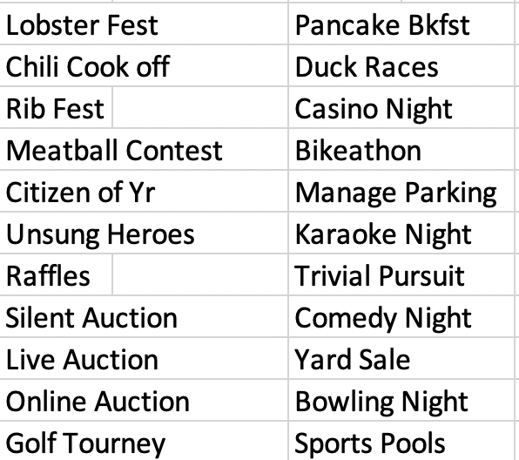
Some Fundraising Ideas

Slide 7
Previous slide listed “events”
There’s also opportunity through Sponsorships
SPONSORS were No 1 Rev Stream in 2 examples
Remember first rule of personal fundraising:
“People give to people”
Biggest mistake: “Failure to Ask!”
Main question to answer: “Where’s my money going?”
Internally, keep your committee informed on a frequent basis

Slide 8
Our Fundraising Plan
What’s the goal? How much do we want to raise?
What are we raising money for?
Is this cause a good “hook”? Is it appealing?
Select a Chair and a Committee
Assign tasks, timelines, schedule meetings
Get a major Sponsor early in the process
Execute

