Slide 1
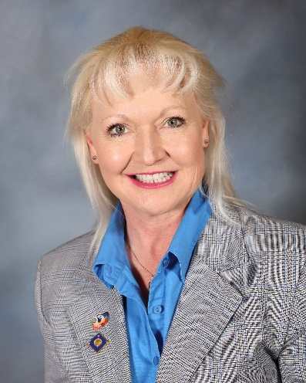
A Leader Plans for Excellence
Facilitator: Dr. Tonya L. Watson
D5495, RC of Flagstaff, AZ
PDG 2016-17
Arch Klumph Society (AKS) & Legacy Society
Notes:
Put YOUR photo and roles in Rotary in here – BUT keep it brief for the intro – not here to talk about us! The Session is 55 minutes long and you will use those 55 minutes

Slide 2
You are a leader now.
Now, plan to be
(an even more) EXCELLENT LEADER!
Notes:
Acknowledge that they are all already leaders in their club, their business, their community. We just want to help them be even more excellent leaders.

Slide 3
Agenda
Welcome
Slide presentation
Story
Intentions
Planning
Effective meetings
Small Group discussions and reports
Take-Aways
Notes:
Keep this brief – by now at 2 minutes with first two slides

Slide 4
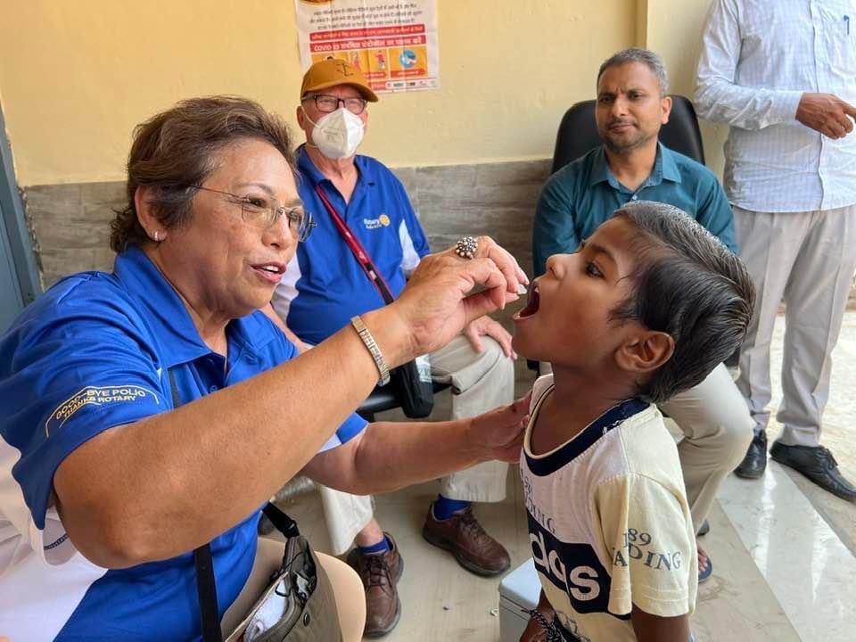
Excellent Leaders Tell a Story
What Rotary story do you tell?
What you want your members get out of Rotary? Their story?
“Rotary moments” are so important
What value is your club providing to members?
Notes:
15 minutes for next 5 slides (no time for dawdling).
These are rhetorical questions, just to get them thinking. Don’t ask for input until Slide #7.

Slide 5
Excellent Leaders Plan Ahead
Some excuses:
“Planning takes too much time.” MAKE TIME! PRIORITIZE!
“I don’t know how.” VISIT LEARNING CENTER AT ROTARY.ORG (as one example)
“I have more important things to do.” NOT REALLY!
Failing to plan is … planning to fail. Period.

Slide 6
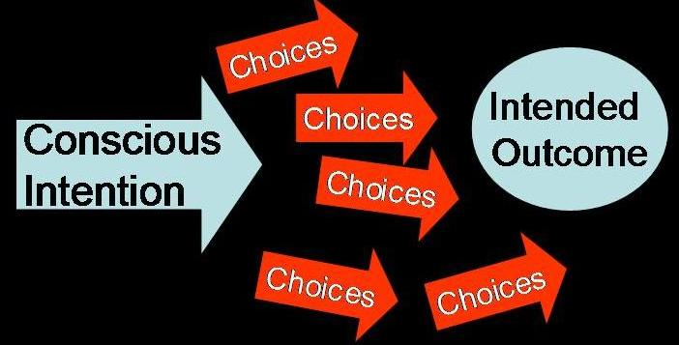
Excellent Leaders Are Intentional
Your intentions for every meeting that support your story?
Your choices based on intentions?
Notes:
These concepts apply to board, committee, and club meetings.

Slide 7
(some) Elements of Excellent Board & Committee Meetings
Remember your intentions; clear objectives
Agenda provided in advance
Pared-down list of participants
Rules/process stated up front and followed by leader
Actionable next steps
Afterward, record or minutes sent to all
Others?
Notes:
These concepts apply to board and committee meetings.
Others? <Open up to comments – limit to 2 minutes>

Slide 8
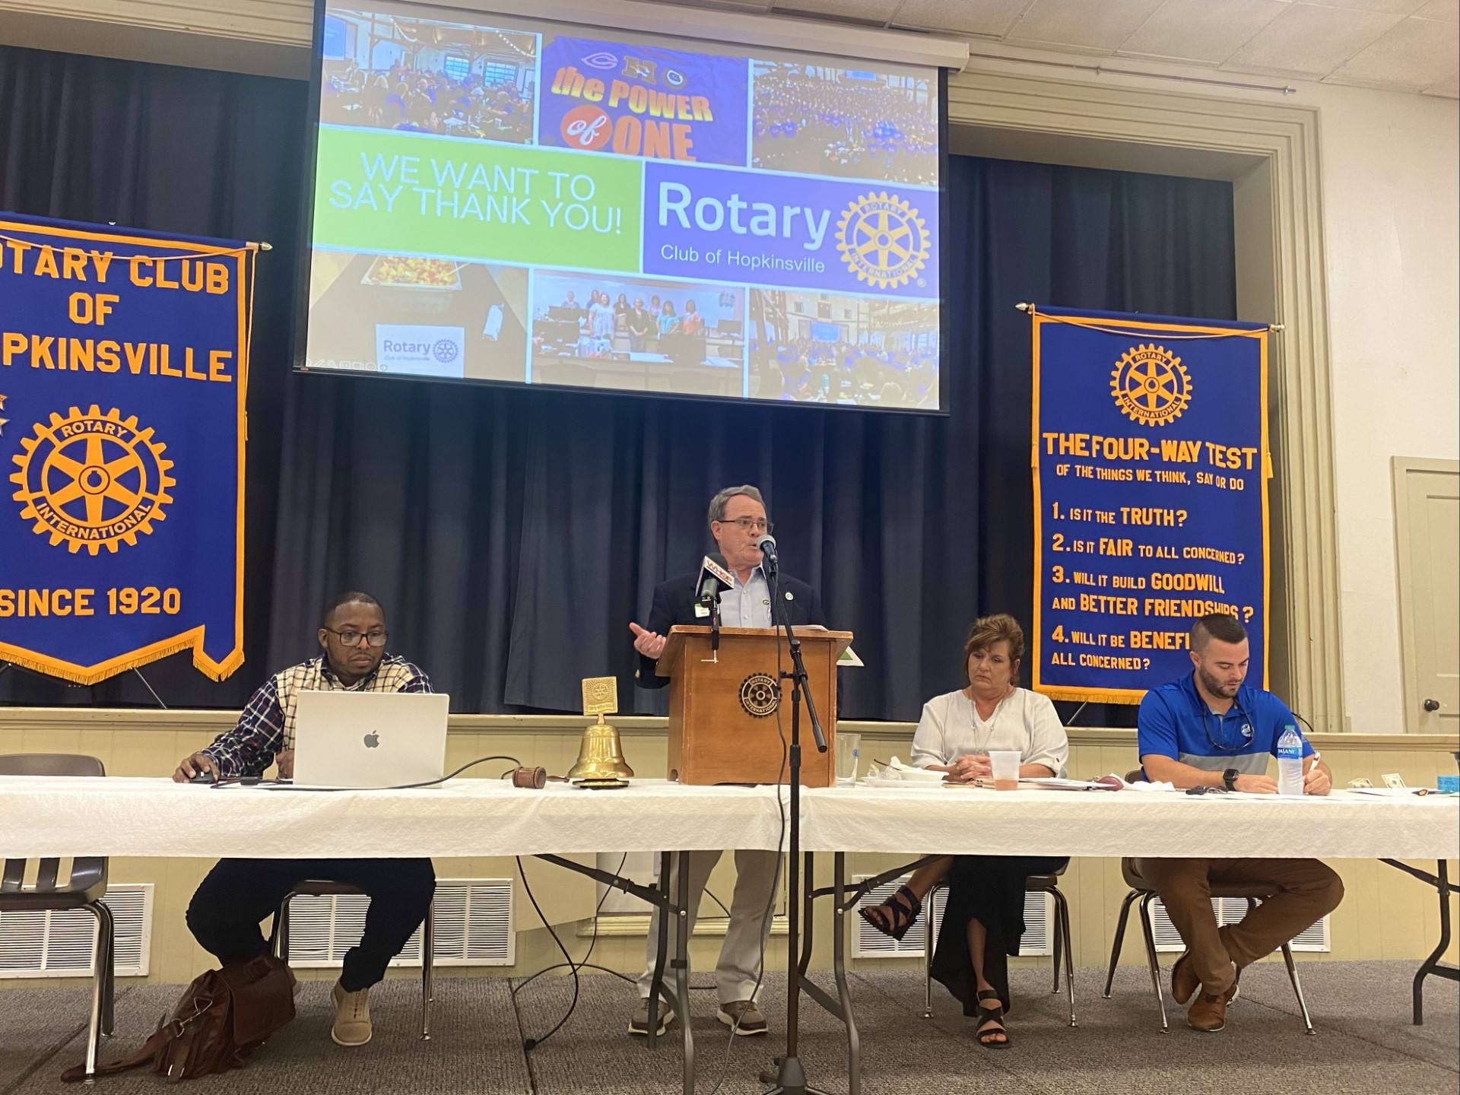
The Importance of Club Meetings
"Rotary Golden Hour"
Ability to paint the face of Rotary for visitors and members each time
Only one chance to make first impression -- requires deliberate thought and advanced planning
Good meetings keep members coming back. Bad meetings keep them away.
Notes:
The next two slides apply to club meetings.

Slide 9
Tips for Excellent Club Meetings
Keep in mind your intentions
Have goals for each meeting
Use RI monthly themes and speakers for those themes
See sample Program Organizer (handout)
Notes:
The next two slides apply to club meetings.

Slide 10
 |  |  |  | PROGRAM ORGANIZER
MONTH |  | July |  | August |  | September |  | October
THEME |  | New Leadership |  | Membership New Club Development |  | Basic Education Literacy |  | Community Economic Development
DATE/TOPIC | 2 | Club President - Goals
 | 9 | District AG -Gov Goals
 | 16 | Club Foundation Chair
 | 23 | Club International Chair
 | 30 | Community Service Ch
MONTH |  | November |  | December |  | January |  | February
THEME |  | Rotary Foundation |  | Disease Prevention and Treatment |  | Vocational Services |  | Peace Building Conflict Resolution
DATE/TOPIC
MONTH |  | March |  | April |  | May |  | June
THEME |  | Water Sanitation Hygiene |  | Maternial and Child Health |  | Youth Services |  | Rotary Fellowships
DATE/TOPIC
Notes:
The next two slides apply to club meetings.

Slide 11
(more) Tips for Excellent Club Meetings
Start and end on time
Ensure good view and hearing of all speakers
Set up & check A/V prior to start
Introduce & welcome guests and visitors
Minimize side discussions
Keep on track; table items if necessary
Notes:
The next two slides apply to club meetings.

Slide 12
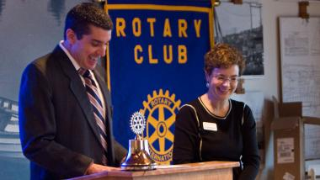
(more) Tips for Excellent Club Meetings
Involve as many members as you can (given time constraints)
Publicly recognize contributions, milestones, efforts, accomplishments
Keep it Fun / Positive / Upbeat!
Use sample Club Program Planner (handout)
Notes:
Others? <Open up to comments – limit to 2 minutes>

Slide 13
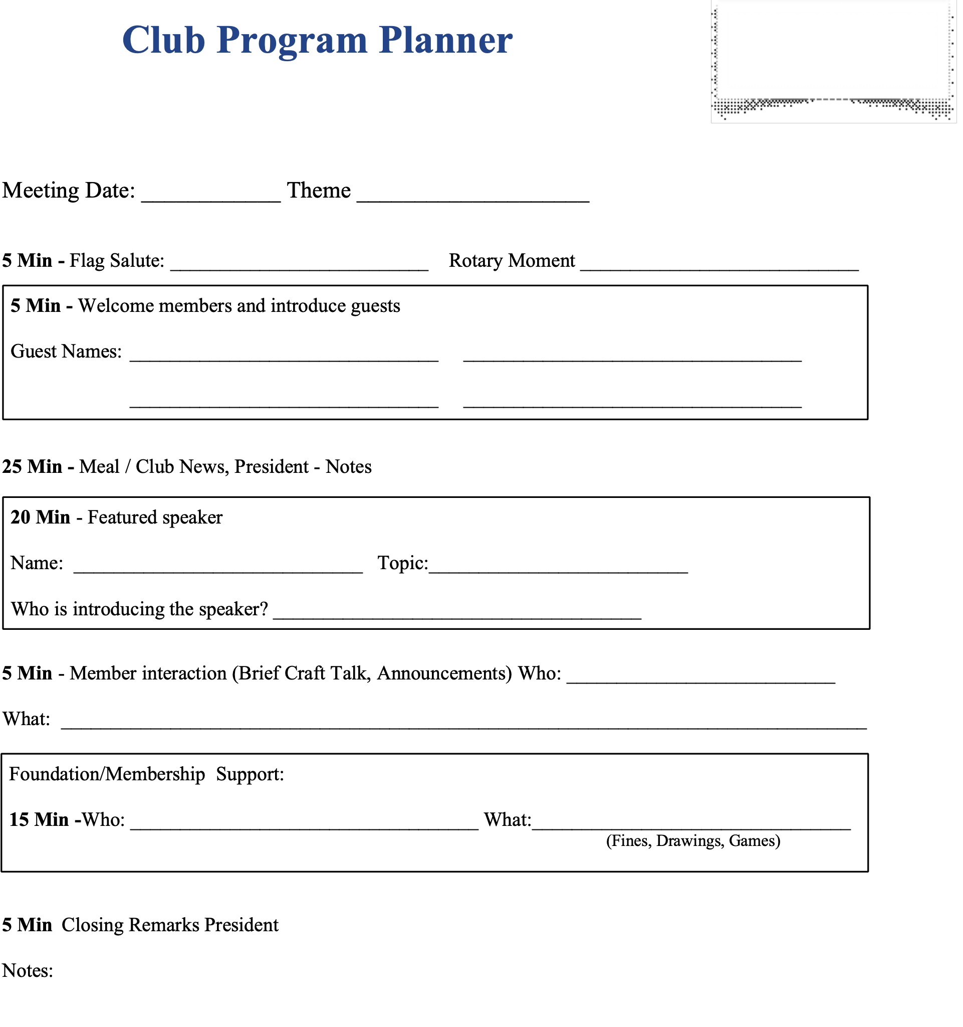
Notes:
The next two slides apply to club meetings.

Slide 14
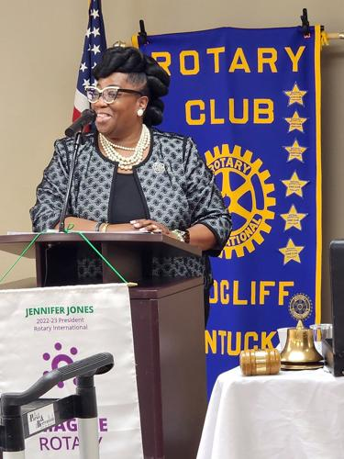
(more) Tips for Excellent Club Meetings
Other tips based on your experience?
Notes:
Others? <Open up to comments – limit to 2 minutes>

Slide 15
Small Group Discussions
Divide into 8 tables (approx. 5 participants)
Select a scribe and spokesperson (can be same)
Each table discusses one common part of typical club meeting: What works well, and what doesn’t?
Table discussion time: 8 minutes
Try to include everyone
Prepare for report-out with 2-minute slot
Notes:
NOTE: Approx. 40 participants. Place RESERVED signs (will be provided) signs on all tables in back of room. Place TABLE NUMBER (1-8) on front tables. Encourage even (close to it) distribution, i.e., around 5 at each table.
Let each table pick a topic by choosing paper slip from a bowl (will be provided). All topics shown on next slide.
30 minutes discussion session
* 1 minute to get organized
* 8 minutes to discuss their topic; less if they are all finished
* 16 minutes report out (2 minutes per table) – most value comes out of these discussions
* 5 minutes for overall comments

Slide 16
Small Group Topics
Start of meeting / welcome of guests
Handling club business
Recognizing members
Member sharing / interaction
Inspiration / Rotary moments
Close of meeting
Things to absolutely avoid doing during meetings
Innovative and creative ways to run meetings
Notes:
At end of report-out by 8th table, open up to comments and questions between groups.

Slide 17
Comments? Questions?
Notes:
Take 1 minute to field questions…longer if you have time left over!

Slide 18
Key Take-aways
Excellence is not an accident
Part of your excellence involves your story, your intentions, your planning
Meetings are KEY parts of a Rotarian’s experience … make them excellent!
Club meetings can help keep members – and can drive members away
Other take-aways for you?
Notes:
5 minutes.

Slide 19
Action Plan
After you leave PETS:
As an excellent leader, how will you help make your members’ Rotary experience excellent?
Notes:
Action plan and conclusion – Tell them to take a quick minute to write a point or two for future action.

Slide 20
Thank YOU for being an Excellent Leader and a Leader of Excellence!
Notes:
Thank them and wish them a great PETS! Bye-bye!

Slide 21
 |  |  |  | PROGRAM ORGANIZER
MONTH |  | July |  | August |  | September |  | October
THEME |  | New Leadership |  | Membership New Club Development |  | Basic Education Literacy |  | Community Economic Development
DATE/TOPIC | 2 | Club President - Goals
 | 9 | District AG -Gov Goals
 | 16 | Club Foundation Chair
 | 23 | Club International Chair
 | 30 | Community Service Ch
MONTH |  | November |  | December |  | January |  | February
THEME |  | Rotary Foundation |  | Disease Prevention and Treatment |  | Vocational Services |  | Peace Building Conflict Resolution
DATE/TOPIC
MONTH |  | March |  | April |  | May |  | June
THEME |  | Water Sanitation Hygiene |  | Maternial and Child Health |  | Youth Services |  | Rotary Fellowships
DATE/TOPIC
Notes:
The next two slides apply to club meetings.

Slide 22
Notes:
The next two slides apply to club meetings.

