Slide 1
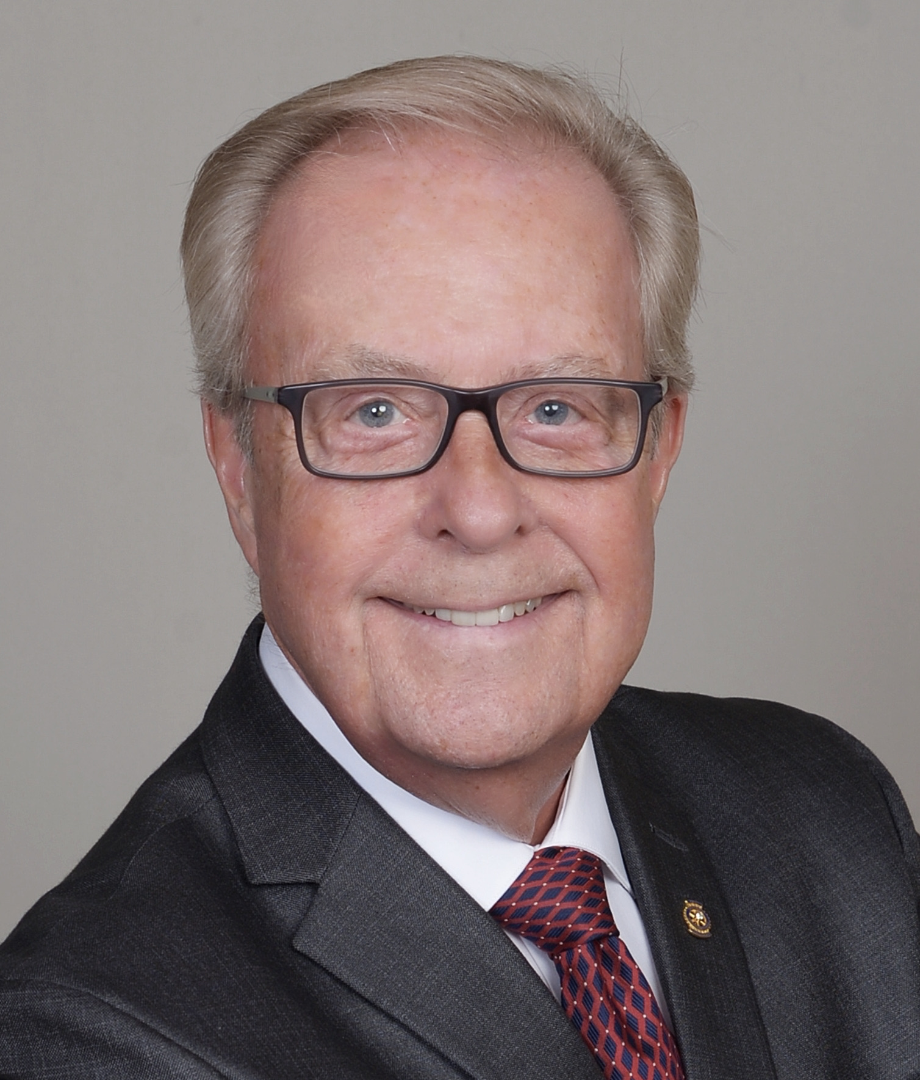
A LEADER IS RELEVANT
Facilitator: Bill Chase, PDG
D6400
D5330
Notes:
Put your photo and your roles into this slide
Very briefly go through this and the Agenda

Slide 2
Agenda
Discussions:
Definition of “Relevant”
What is a relevant Rotary club president?
In the Rotary World, how can we, as club presidents, help our members be relevant in out community?
Breakout:
Team Exercise
Discussions:
How can we provide targeted (relevant) services to our community?
What are key elements in engaging community?
Notes:
Keep this brief – by now at 2 minutes with first page introduction

Slide 3
Definition of ”Relevant”
Closely connected or appropriate to what is being done or considered.
Appropriate to the current time, period, or circumstances; of current interest
Notes:
At question mark, throw that question out to the group, bring them into the conversation. – 5 minutes total for the slide

Slide 4
What is a “relevant” Rotary club president?
Notes:
At question mark, throw that question out to the group, bring them into the conversation. – 5 minutes total for the slide

Slide 5
In the Rotary World, how can we, as club Presidents, help our members be relevant in our community?
Notes:
Ask the question. – We Can’t be Political leaders; we Can’t be religious leaders; We Can be service leaders who promote community service: Service Above Self – 7 minutes here

Slide 6
TEAM EXERCISE
We will divide the room in half creating 2 teams
Teams will have 10 minutes to consider and discuss their topic
Select one person from your team to be the Spokesperson
That Spokesperson will have up to 3 minutes to report on the findings of their team
Notes:
Explain how this Team Exercise will work - 1 minutes

Slide 7
TEAM EXERCISE QUESTIONS
Team #1: As a service leader, in what ways can a Rotary club be relevant to its members?
Teams #2: As a service leader, in what ways can a Rotary club be relevant to its community?
Notes:
Ideas for Team #1: Providing a pathway to personal involvement and service; may serve as a platform for opinions; provide opportunities for leadership: and they will receive a family of support.
Ideas for Team #2: It may provide resources; the club is always available to them; we are always open to ideas; and we focus on SERVICE. 10 minutes

Slide 8
TEAM EXERCISE REPORTS
Team #1: As a service leader, in what ways can a Rotary club be relevant to its members?
Teams #2: As a service leader, in what ways can a Rotary club be relevant to its community?
Notes:
Ideas for Team #1: Providing a pathway to personal involvement and service; may serve as a platform for opinions; provide opportunities for leadership: and they will receive a family of support.
Ideas for Team #2: It may provide resources; the club is always available to them; we are always open to ideas; and we focus on SERVICE. 5 minutes

Slide 9
How can we provide targeted (relevant) services to our community?
Notes:
Ideas to generate discussion: Ask communities what they need; invite communities to help address their need (work with their governance representatives, etc); Tell them what’s going on; and, thank them for their help. 7 minutes

Slide 10
What are key elements in engaging with our communities?
Notes:
Ideas for discussion points: Communication/public relations efforts; invitations to join our club service projects and activities – 7 minutes

Slide 11
Questions?
Notes:
Take 1 minute to field questions…longer if you have time left over!

